Slide 1
This is a template for a short in-class activity to review or preview characters. The first two slides are title slides you can use to introduce the activity (either one or both), the next two can be used to introduce the activity and illustrate how the activity works using a very simple example. The last two slides are templates you can use to create your own slides by simply adding characters in textboxes under the numbers.
The activity works like this:
There are four characters displayed on the screen, each under on of the numbers
There of the characters are the same, one is different
Students are given a brief amount of time (maybe 10 seconds) to look at the screen
Then the teacher prompts students to either say a number or show the number using their fingers
Then the teacher reveals what the correct answer is
Repeat with new characters on additional slides
Note: though not necessary, the activity is more interesting if characters are displayed in different fonts (楷体、黑体、宋体、等等)
– activity originally designed by Eric Pelzl –

Slide 2
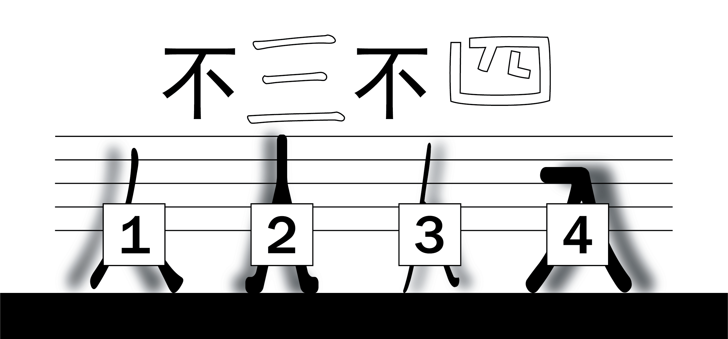
– activity originally designed by Eric Pelzl –

Slide 3
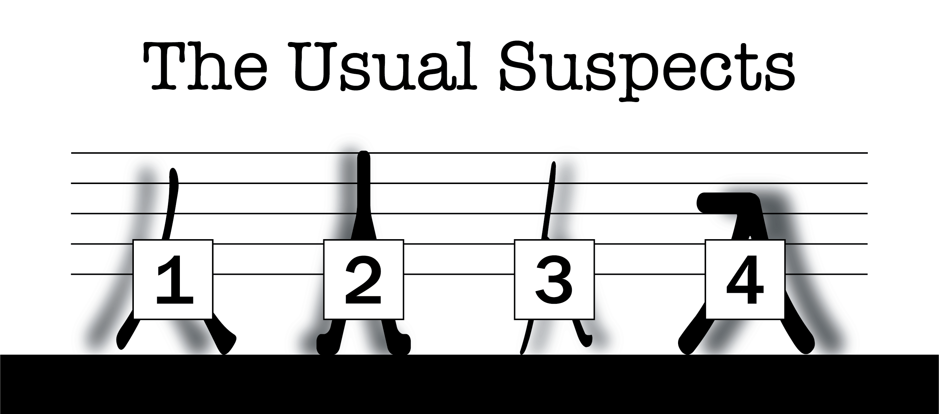
– activity originally designed by Eric Pelzl –

Slide 4
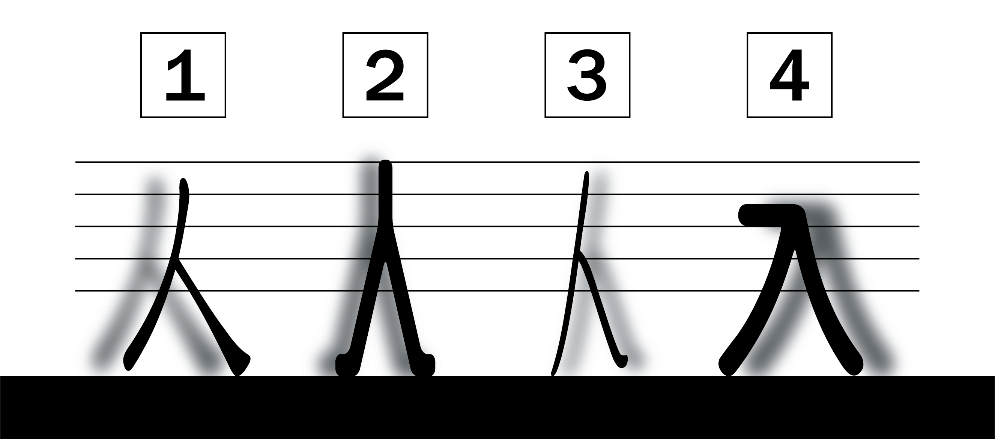
– activity originally designed by Eric Pelzl –

Slide 5
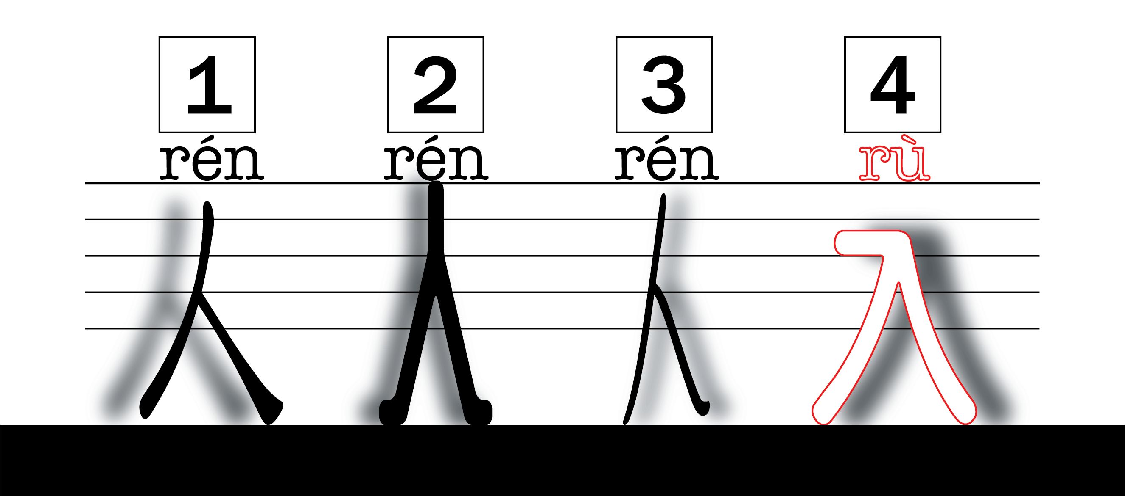
– activity originally designed by Eric Pelzl –

Slide 6
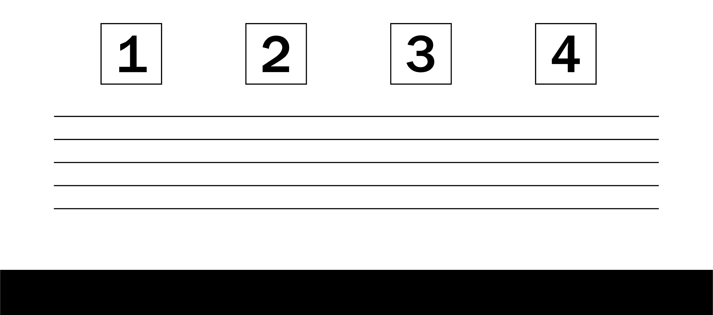
大
太
太
太
– activity originally designed by Eric Pelzl –

Slide 7
– activity originally designed by Eric Pelzl –

