Slide 1
This is a template for a short in-class activity to practice words that sound very similar to your students. The obvious example is words that differ only in tones (免费 vs. 面肥), but it could be any words that students think sound similar (继续 vs. 技术). For this activity, students only need to know ONE of the two words (it’s not a problem if they know both, but it’s not necessary that they do).
The first slide is just a title slide that you can use to start the activity. The reason to use that slide is simply as a cue—once students have learned how to do the activity, you just show that slide and they know what the activity is, no need to explain it.
The other slides are illustrations of how you might use the activity.
To prepare, all you need to do is find some images that go with the similar sounding words, or even just type the words (with Pinyin notes so that students know the correct pronunciation).
Then you say simple sentences that students will understand using those words. Sometimes the sentence makes sense, sometimes it will not. Students respond by either saying xíng or bù xíng, or you could have them give thumbs up or down.
Notes: One challenge for second language learners is that when words sound similar, they often only know ONE of the words, so they don’t feel the importance of tones (or other small differences) that make the words sound different. The aim of this activity is to help raise learners’ awareness of how minor pronunciation difference can be important. For this reason, they only need to know ONE of the TWO words you show them. The other words is there simply to show how mispronunciation might produce strange sounding sentences.
– activity originally designed by Eric Pelzl –

Slide 2
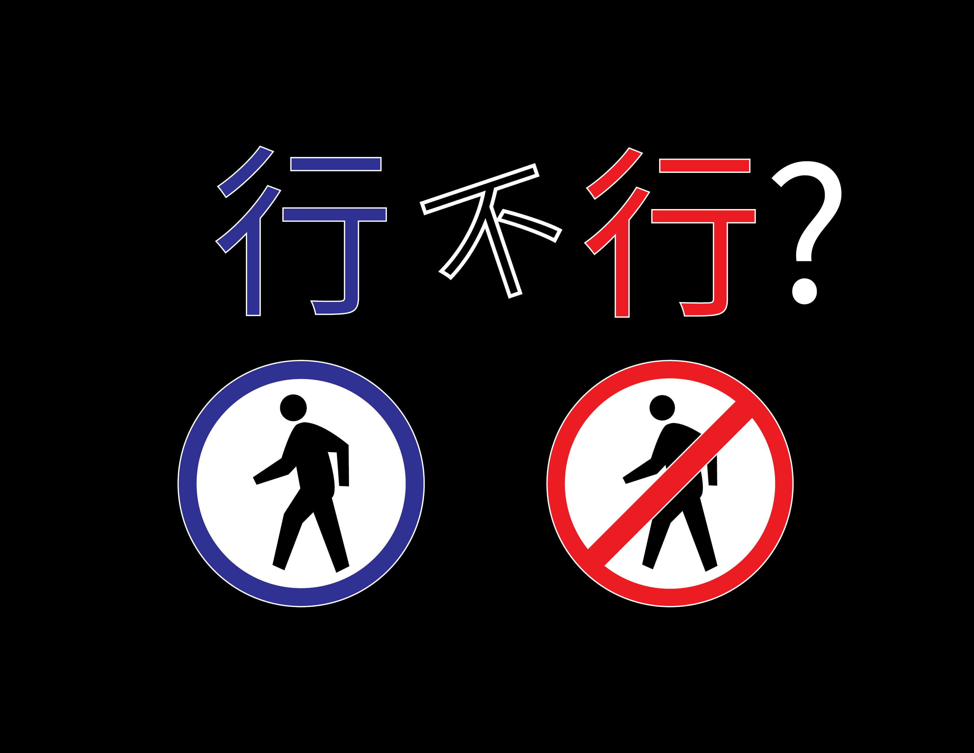

Slide 3
xíngrén
xìngrén
老师：这个句子行不行？“我喜欢吃行人”
学生：不行！
Images from Wikimedia Commons
Pedestrian sign: https://commons.wikimedia.org/wiki/File:Signal_in_Al_Khor.jpg
Almonds: https://commons.wikimedia.org/wiki/File:Almonds.png

Slide 4
xíngrén
pedestrian
xìngrén
almond
行人
杏仁
老师：这个句子行不行？“街上行人很多。”
学生：行！

Slide 5
xíng
xìng
行
姓
老师：“我行张。”
学生：不行！

